Slide 1
SatNOGS
Presented by Jonathan Brandenburg
2015-11-21

Slide 2
What is SatNOGS?
SatNOGS is an open source ground station and network, optimized for modularity, built from readily available and affordable tools and resources.¹
What does that mean? The SatNOGS team wants to create a global network to receive satellite transmissions.

Slide 3
What Is SatNOGS?
Ground Station
Hardware and software for an antenna rotator
3D printed parts
Arduino controller
Several antenna designs
Software-defined radio using a Raspberry Pi or BeagleBone Black

Slide 4
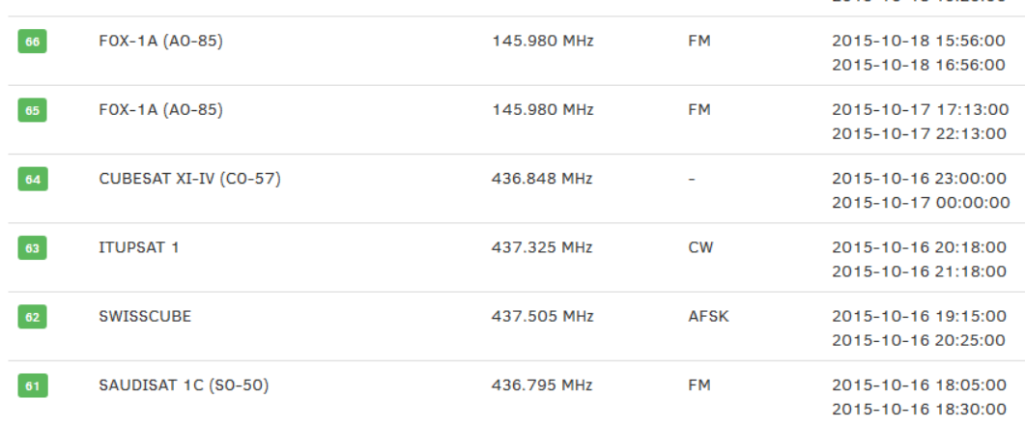
What is SatNOGS?
SatNOGS Network
Database of satellites
Scheduling and dispatch system

Slide 5
Rotator
3D printed parts
A few flaws in the models
2 circuit boards
A few electronic components
Stepper motors, stepper drivers
Optical interrupters, power supply
Capacitors, pins, screw terminals
Some hardware
Bearings, shaft collars
Various screws, washers, nuts
Antenna mast
Custom acrylic case
Arduino and software
Raspberry Pi and software

Slide 6
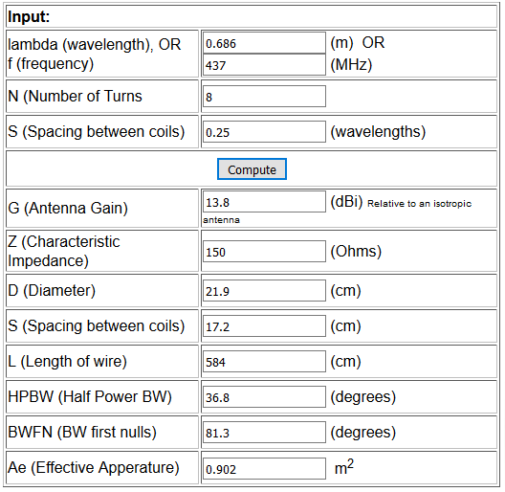
Antenna
Both Yagi and Helical
I’m most interested in the helical!
A few parts
3D printed parts, fiberglass rod
Galvanized steel wire
Brass sheet, galvanized steel grid
RF connector, a little hardware
It can be customized!
https://tinyurl.com/8ymj9mt

Slide 7
Demonstration

Slide 8
What about the Raspberry Pi?

Slide 9
Image Credits
¹ https://satnogs.org, 2015-11-03

